Slide 1




WATER CONSERVATION :
REAL DRINKING-WATER QUALITY IN GERMANY
Group 7
Zahra Alrosani
Fatema Sultan
Reem Alansari

Slide 2
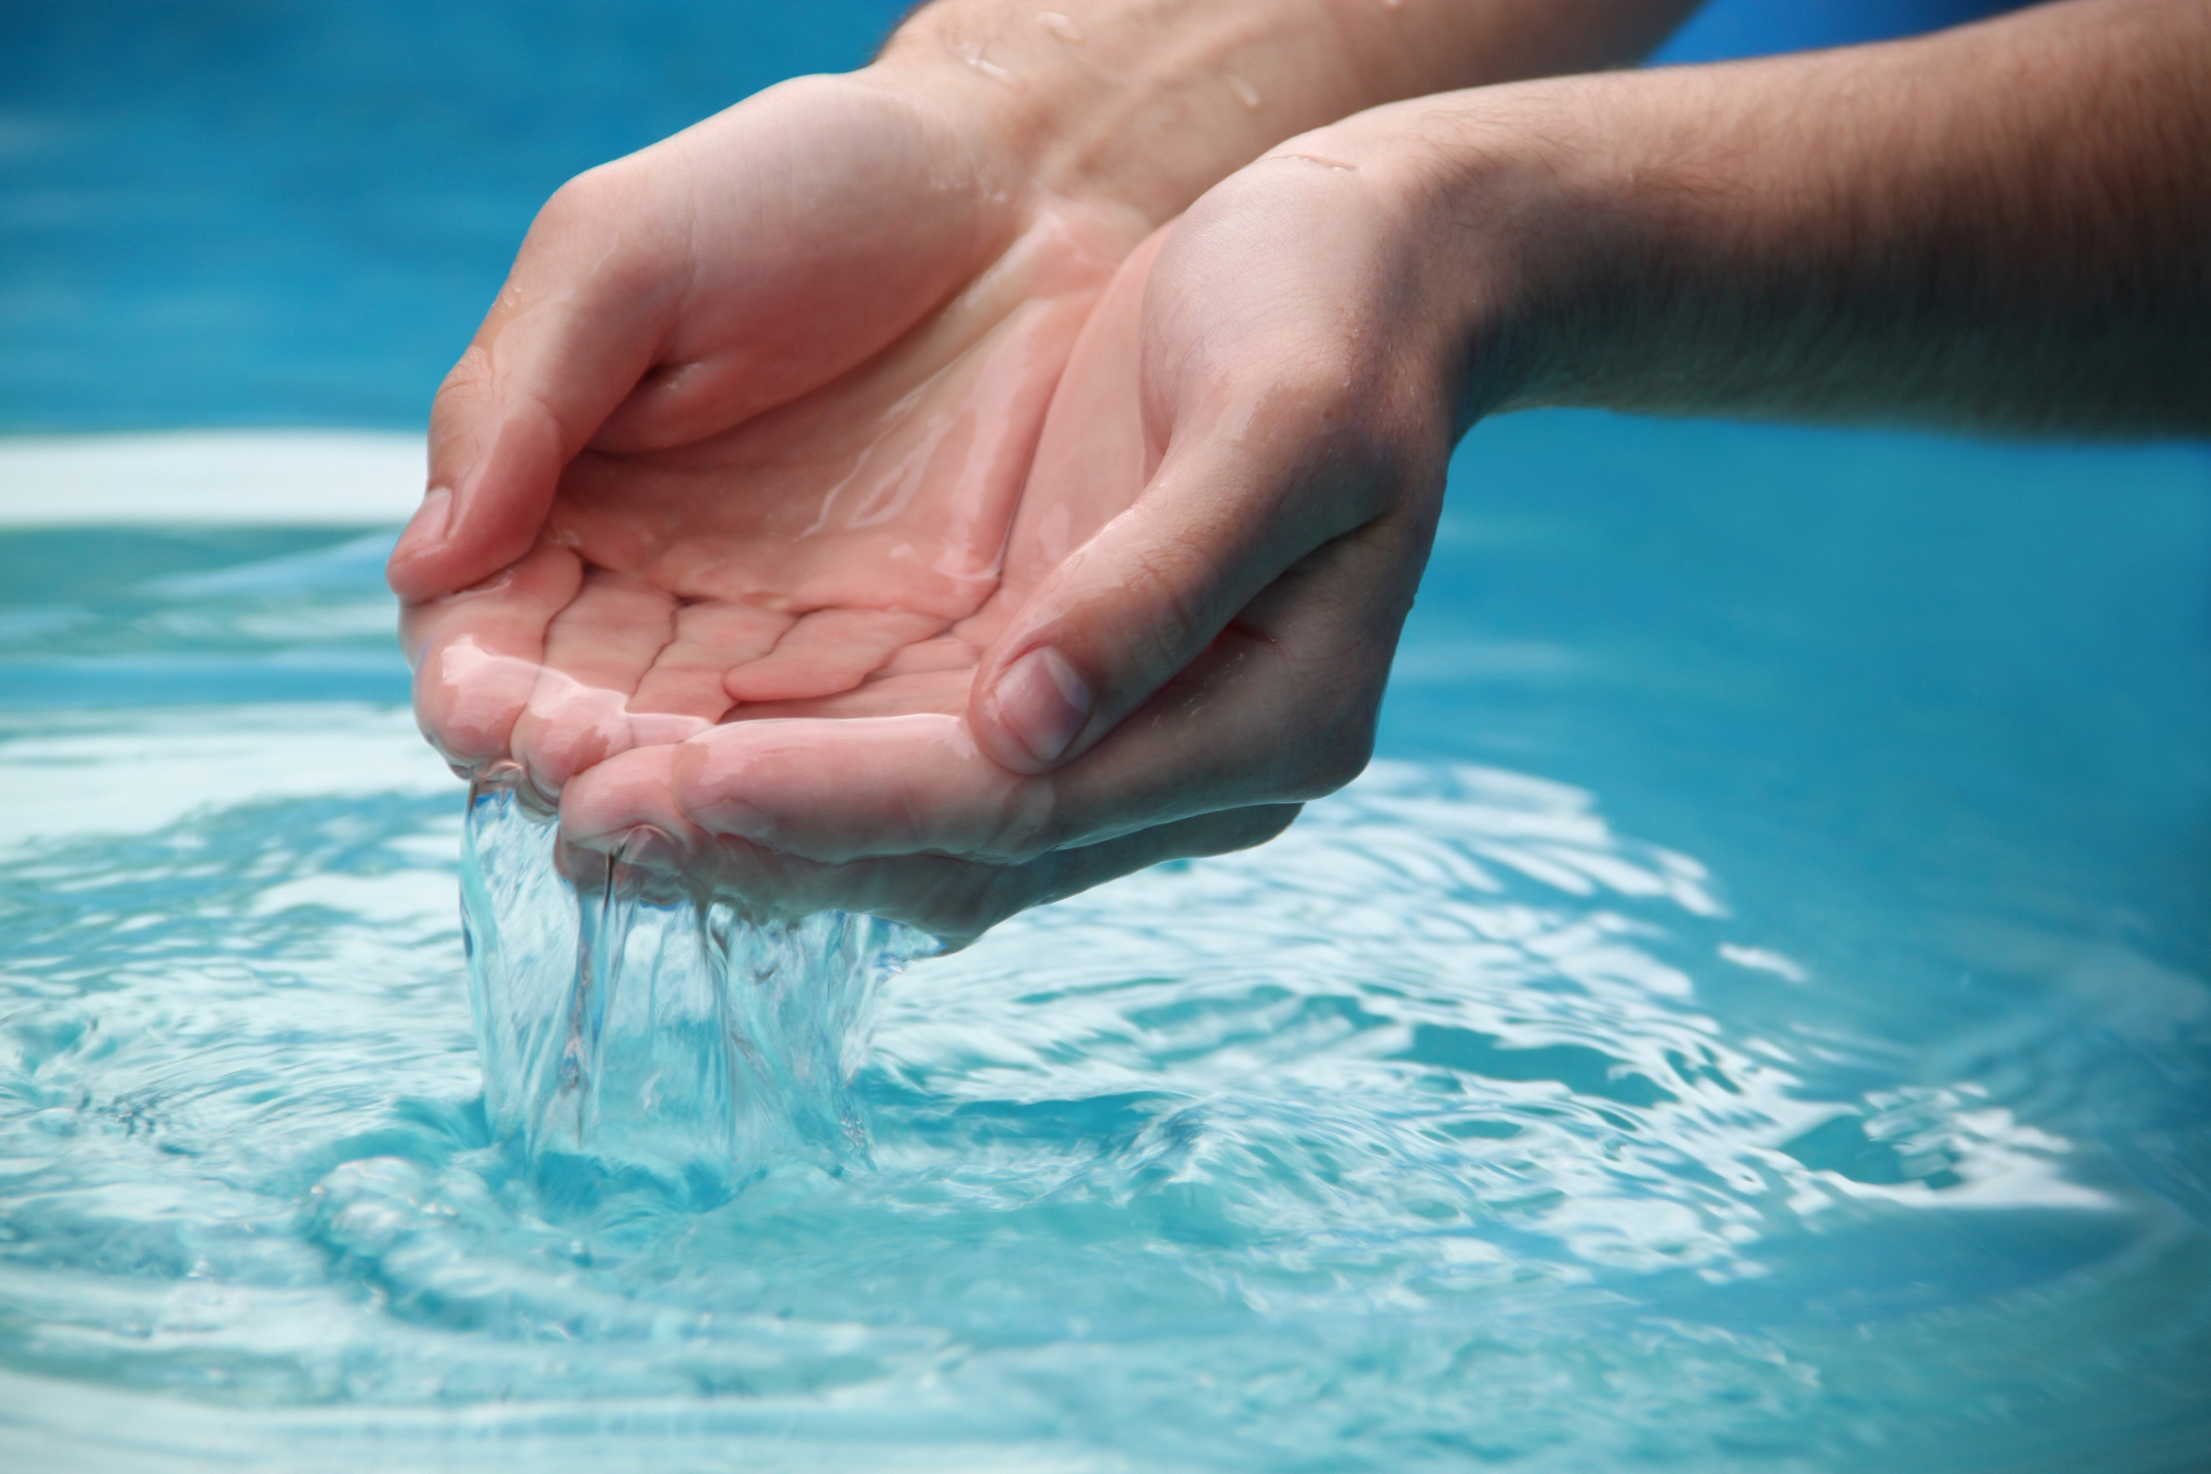

Problem Statement:
Unexpected variations in the data indicate potential underlying factors that need thorough investigation. These fluctuations may stem from operational, environmental, or regulatory influences, directly impacting overall system efficiency and stability. Identifying key trends and patterns is essential to ensure consistency and optimize performance.

Slide 3
Approaches
Investigating Unusual Water Temperature Behavior by Season
Analyzing Extreme Values on a Specific Day
Reviewing All 'True' Events and Understanding Their Impact

Slide 4
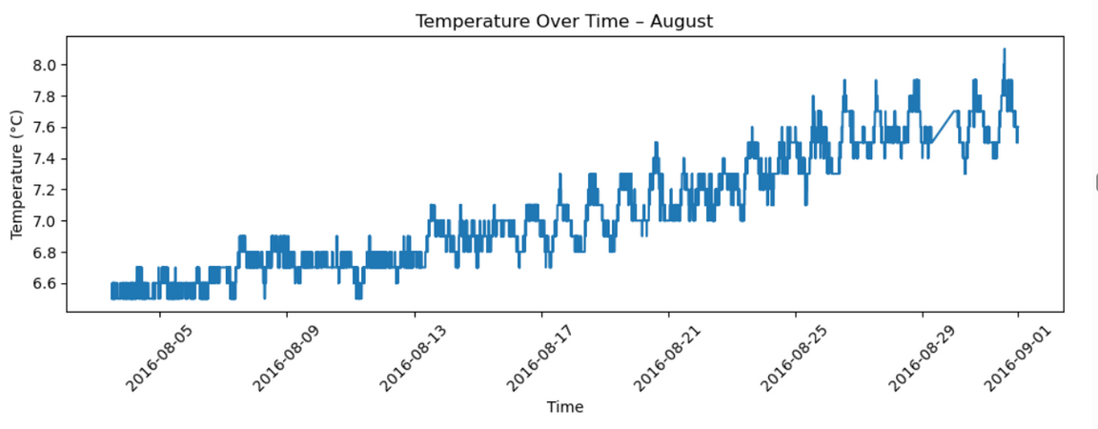
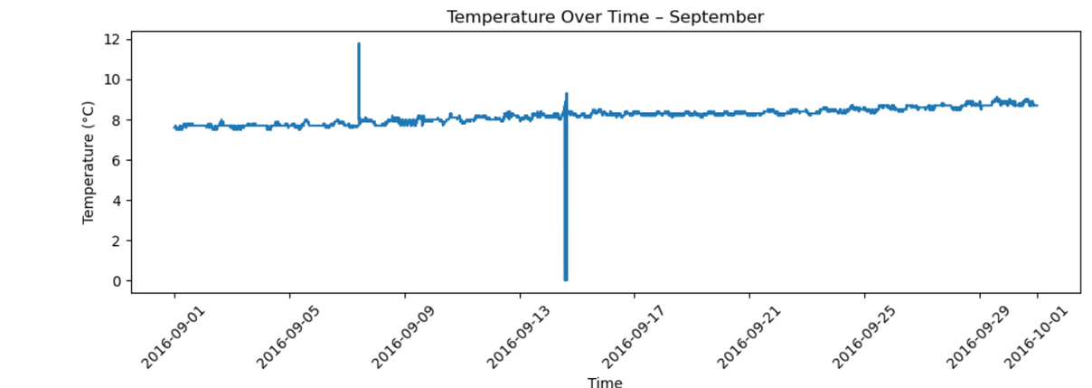
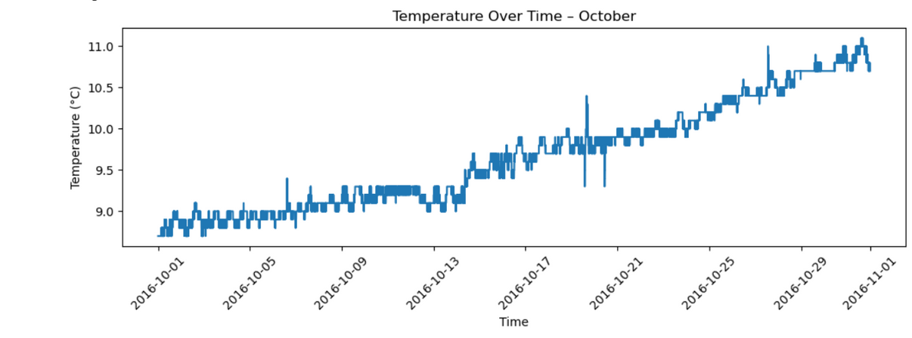
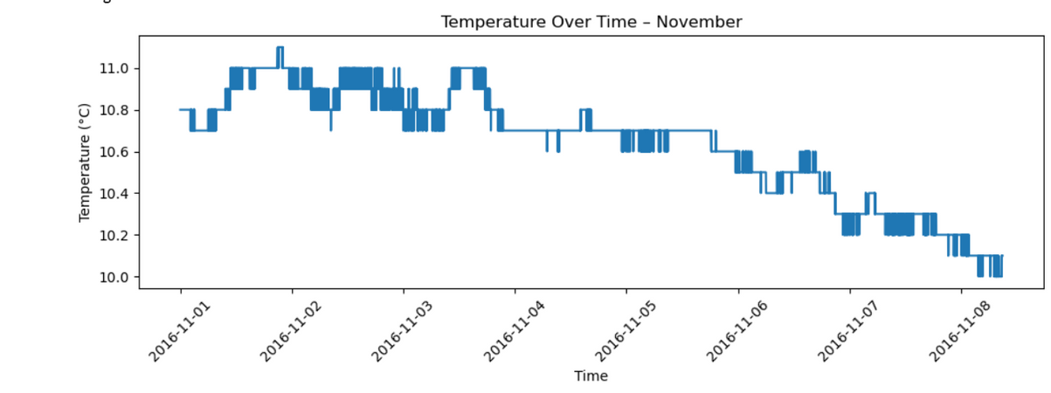
Water Temperature in each month

Slide 5
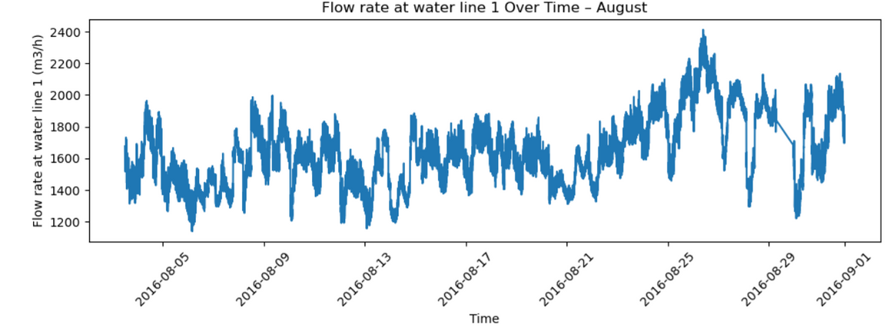
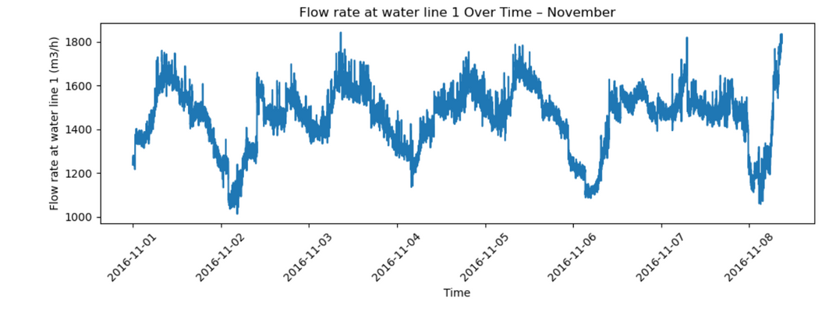
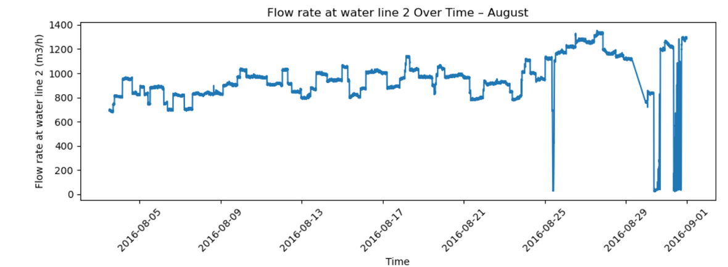
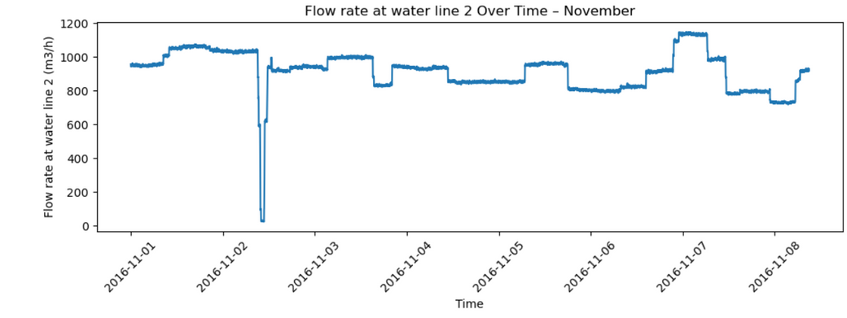
Water Flow Rates in Aug & Nov

Slide 6
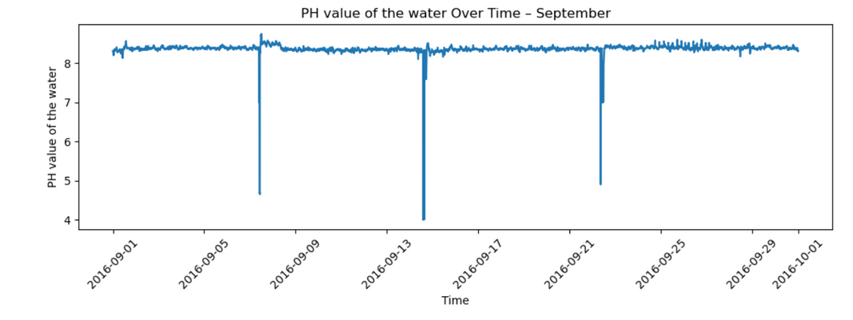
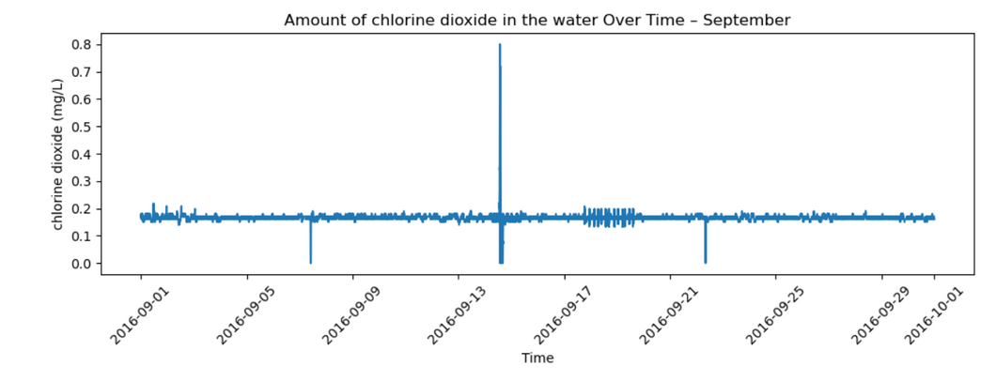
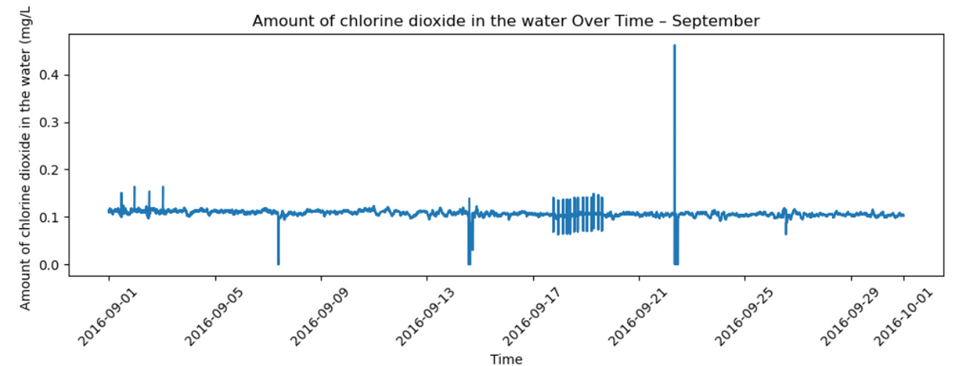
September month observations

Slide 7
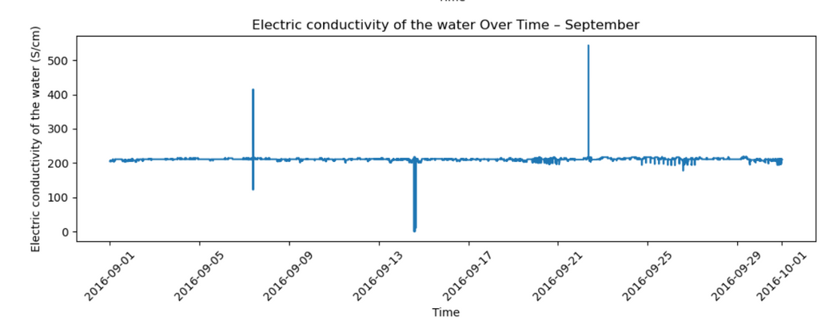
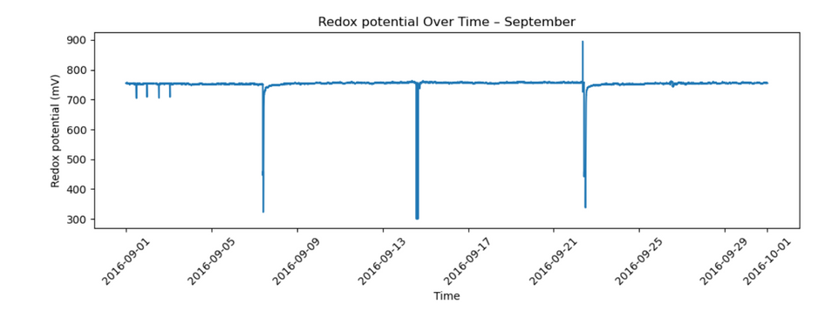
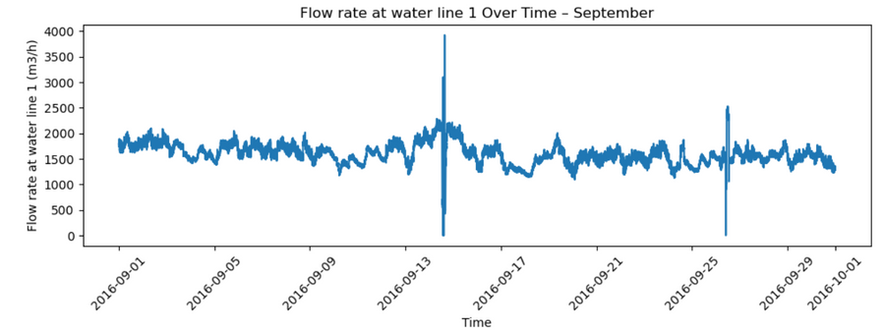
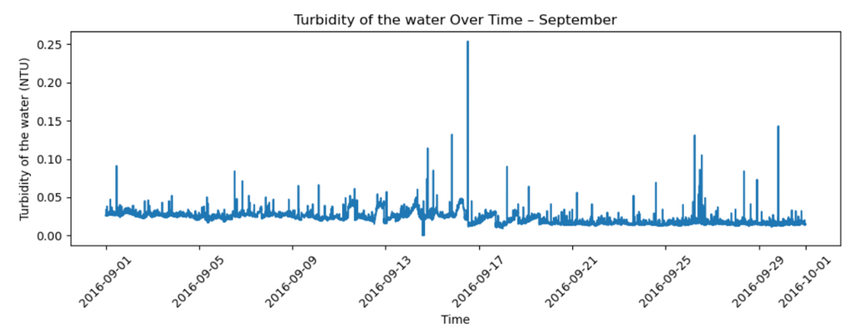
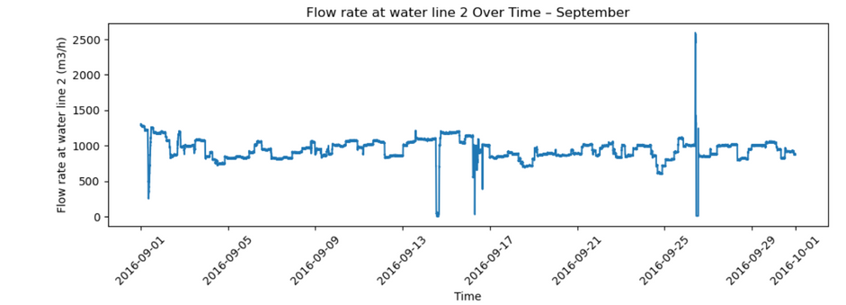
September month observations

Slide 8
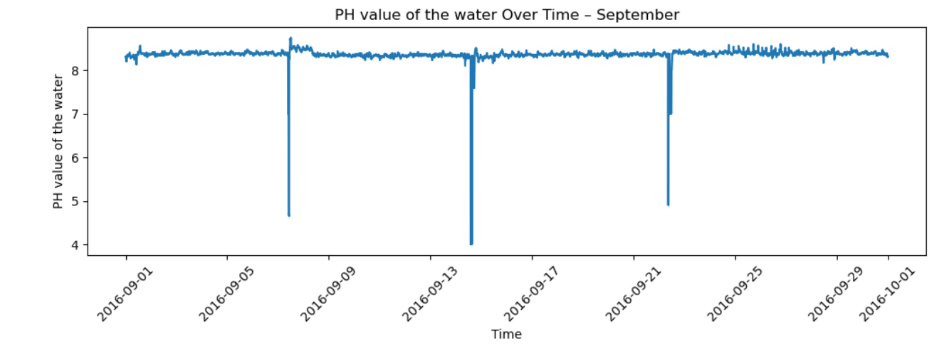
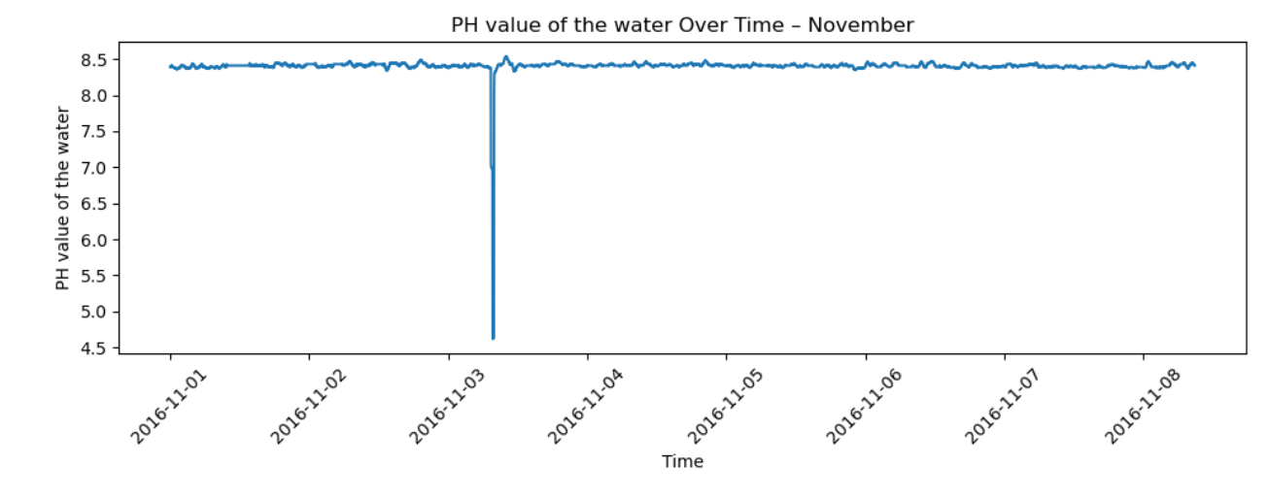
Water not suitable to drink

Slide 9

Recommendations
Strengthen Monitoring and Classification of ‘True’ Events.
Improve Communication on Seasonal Water Temperature Behavior.
Conduct Sensor Health Audits.

Slide 10

THANK YOU

